Slide 1

Health Savings Account Overview
Prepared for Bentley University
Notes:
Cover/Title Slide

Slide 2
Health Savings Account Considerations

Slide 3
Health Savings Account Overview
A Health Savings Account (HSA) is a savings account used in conjunction with a High-Deductible Health Plan and allows users to save money, tax-free, on qualified medical, prescription drug, dental and vision expenses.
HSA contributions are made tax-free and the funds can grow tax-free via investments. You can invest your HSA balance once you have $2,000 in your account.
The funds can also be distributed from the account tax-free (as long as they are used for qualified medical, prescription drug, dental, and vision expenses).
You may not contribute to both an HSA and traditional Health or Medical Flexible Spending Account (FSA) at the same time.
The Dependent Care FSA is not impacted by HSA contributions.

Slide 4
Other HSA Considerations
You may only contribute to an HSA when you are enrolled in an HSA-qualified health plan, such as the one offered by Bentley University.
You may not contribute to an HSA if:
  You are enrolled in Medicare
  You are enrolled in other health coverage
  You or a spouse is contributing to a Health FSA
You may access your HSA funds even after you lose the eligibility to contribute to the account.
You may increase or decrease your contribution amount at any point during the year, up to the specified maximums.

Slide 5
Completing the Account Setup Process

Slide 6
Completing the Account Setup Process
In order to utilize your HSA funds, you will need to complete the process of opening your HSA by logging into your online account and accepting the Terms and Conditions. Here is an overview of the Terms and Conditions:
  Custodial Agreement: specifies all rules associated with the account including eligibility rules, contribution rules, responsibilities of all parties, and operating rules.
  Electronic Disclosure: defines the method by which you will receive all documentation related to your HSA.
  Patriot Act Requirements: a required check to ensure that all accountholders have been verified, allows Sentinel to request backup documentation if and when needed to validate an accountholder’s identity.

Slide 7
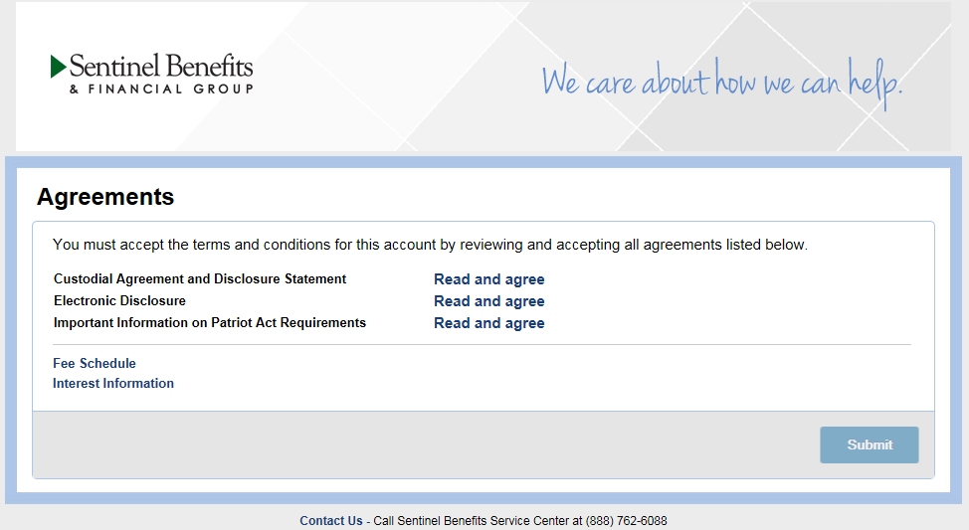
Terms and Conditions Overview
When you log into your account for the first time, you will be prompted to read and accept the terms of the agreements.
Important Note! You will not be able to “Read and agree” to any of the terms until you scroll to the bottom of the given statement or disclosure. At that point the agreement check box will become available.

Slide 8
Navigating Your Online Portal and Mobile App

Slide 9
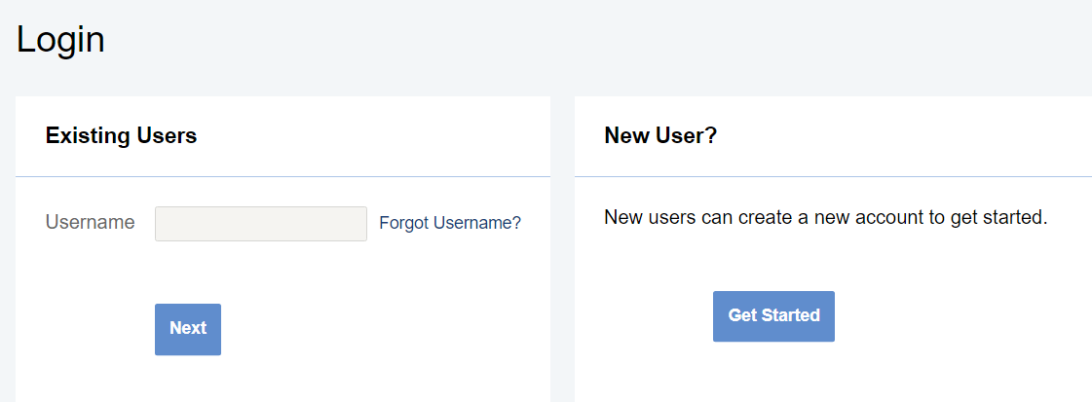
Accessing Your Online Account
Steps to log into the site:
  Go to https://www.sentinelgroup.com/
  Select “I am an Individual” and choose “FSA, HSA, HRA, Commuter Accounts” from the “Login” drop-down menu.
  If you have logged into the website in the past for FSA, you will use the “Existing Users” option and use those same credentials to access your HSA.
  If this is your first time logging into the site, use the “Get Started” button under “New User?” to create your account.

Slide 10
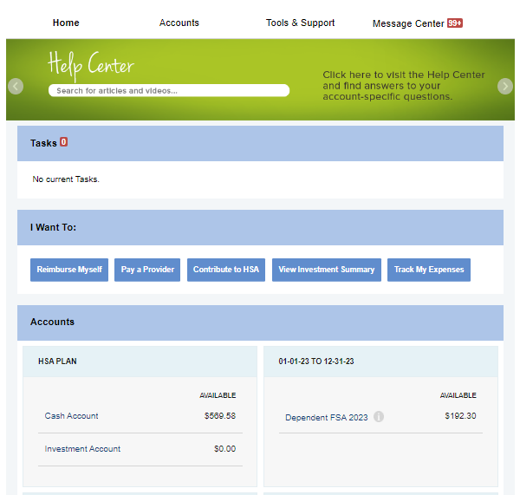
Your Online Account: Home
From your Home page, navigate to the other available pages using the menu bar at the top of the screen, or use one of the “I Want To…” quick links for the most commonly used functions.
Quickly view your available balances, including the breakdown between your cash and investment accounts

Slide 11
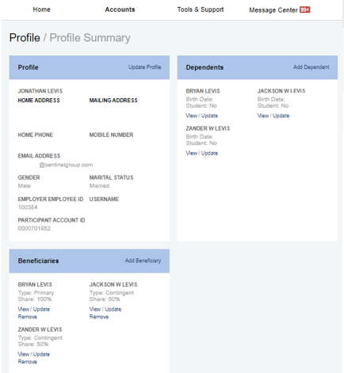
Your Online Account: Profile
Update your profile to change or add an email address or phone number
Add dependents in order to track your spending across each member of your family
Designate a beneficiary for your HSA. Note: Designating a beneficiary who is not your spouse will trigger certain tax consequences

Slide 12
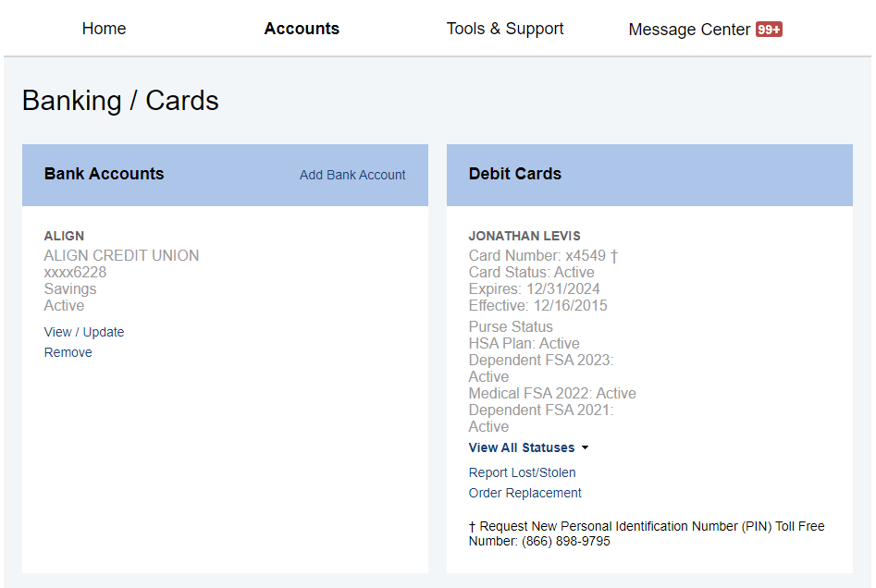
Your Online Account: Banking/Cards
Add a bank account in order to quickly transfer money into or out of your HSA
Manage your Benny Cards by viewing your current card information, or by ordering an additional set via “Order Replacement”

Slide 13
Sentinel Benefits Mobile App
Download the Sentinel Reimbursement Accounts app in the Apple and Android app stores. From your mobile app you will be able to:
View account balances
Make an HSA transaction
Store an expense and upload receipt(s)
Receive account notifications

Slide 14
Contributing to Your HSA

Slide 15
Contribution Information
Self-Only Coverage Contribution Max (2023):
$3,850*
Employee contributions can be made via payroll deduction or outside of payroll (i.e., via check or bank transfer). Please note that there are tax considerations when contributing outside of payroll.
You may contribute at any time during the year, as long as you remain covered by the HSA-eligible health plan.
Unlike a Health FSA, you only have access to the funds as they are contributed.
Also unlike an FSA, your account is yours for life (even if you were to terminate employment from Bentley).
Family Coverage Contribution Max (2023):
$7,750*
*Individuals over age 55 can contribute up to $1,000 more per year

Slide 16
Spending Your HSA Funds

Slide 17

Spending Option 1: The Sentinel Benny Card
Employees participating in the HSA will receive a set of two cards. Your cards are good for a period of three years.
You must activate your card before it can be used.
HSA contributions will be added to your card, which can then be used to pay medical, dental, and vision expenses.
Important Note! The amount in your Cash Account is the amount available on your Benny Card at any given time. If you want to swipe your card for a higher amount, you will have to move funds from your Investment Account to your Cash Account. Please see the “Investing Your HSA Funds” section for more detail on investing.

Slide 18
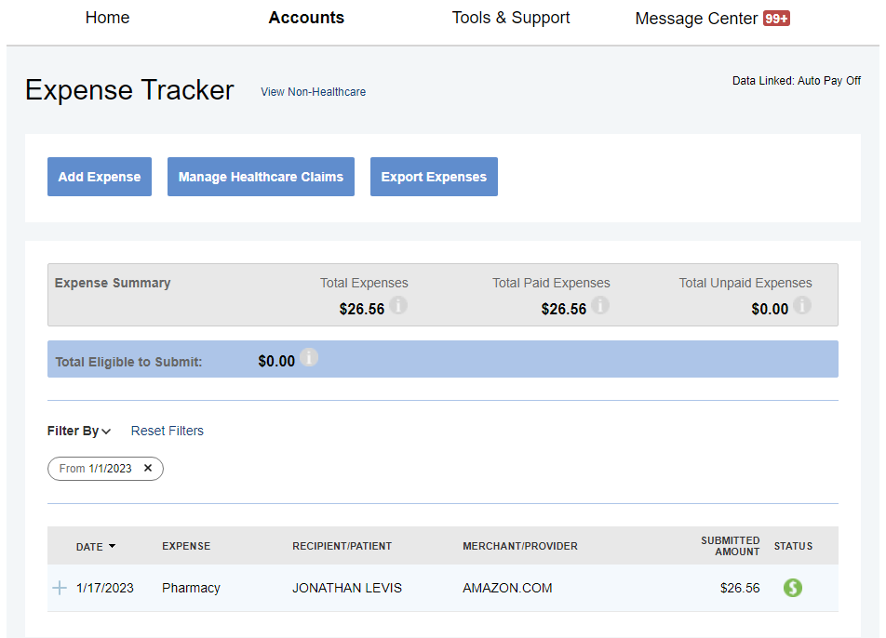

Spending Option 2: Using Your Expense Tracker to Reimburse Yourself or to Pay a Provider Directly
When you incur an eligible expense and pay for that expense using something other than your Benny Card, upload that receipt and then add the expense to your Expense Tracker by clicking on “Add Expense
Once an expense is added, click “Pay” to have that expense reimbursed out of your HSA

Slide 19
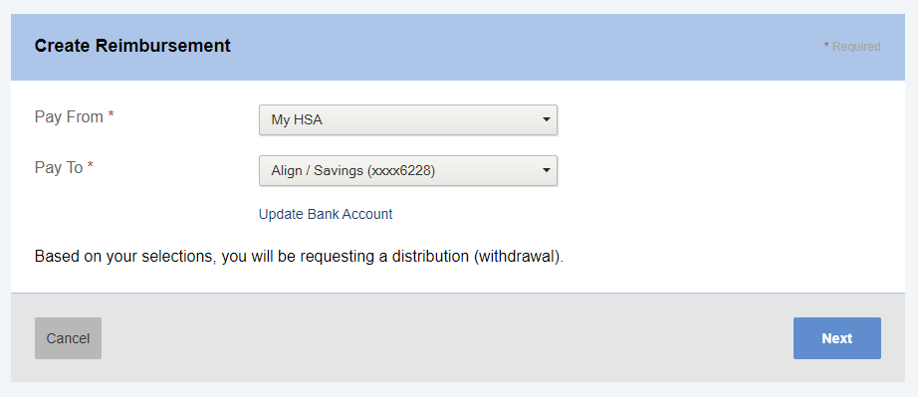
Spending Option 2: Using Your Expense Tracker to Reimburse Yourself
Choose to move money from “My HSA” to one of the bank accounts that you have on file and then select “Next” to walk through the final steps

Slide 20
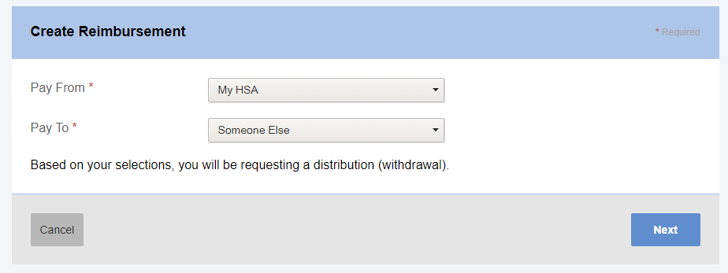
Spending Option 2: Using Your Expense Tracker to Pay a Provider Directly
Alternatively, you may choose to send funds from your HSA directly to a provider.
Simply choose “My HSA” in the “From” section and “Someone Else” in the “To” section.

Slide 21
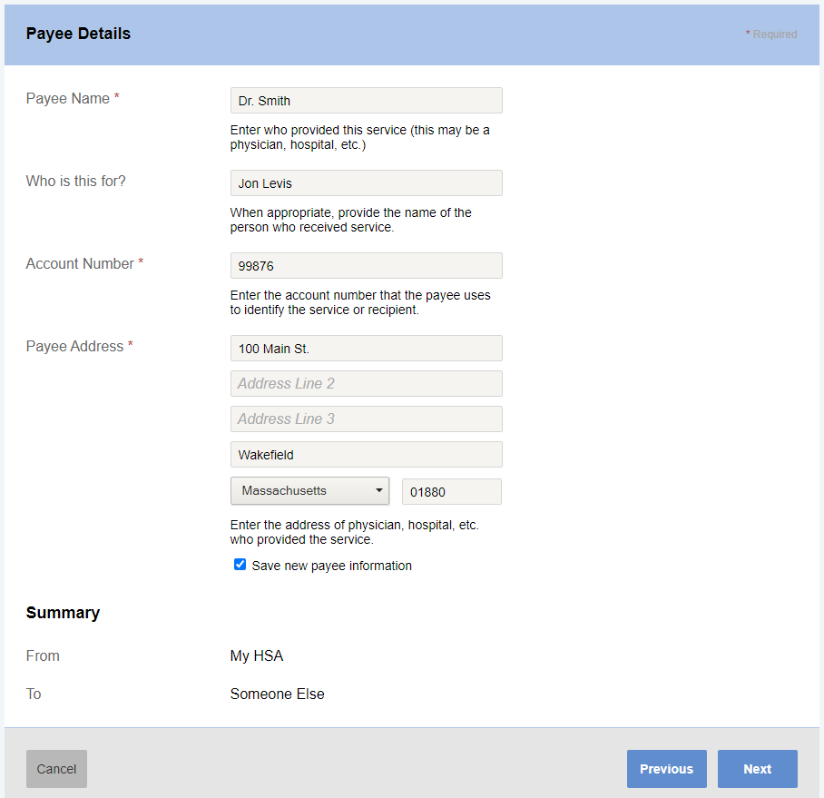
Spending Option 2: Using Your Expense Tracker to Pay a Provider Directly
Enter the name of your doctor or provider under the “Payee Name”
Enter the account number associated with you or your dependent at that provider
Enter the payment address for check mailing
Save your provider for a future payment request by checking off “Save new payee information”
Click Next to complete the steps and to issue the payment

Slide 22
Investing Your HSA Funds

Slide 23
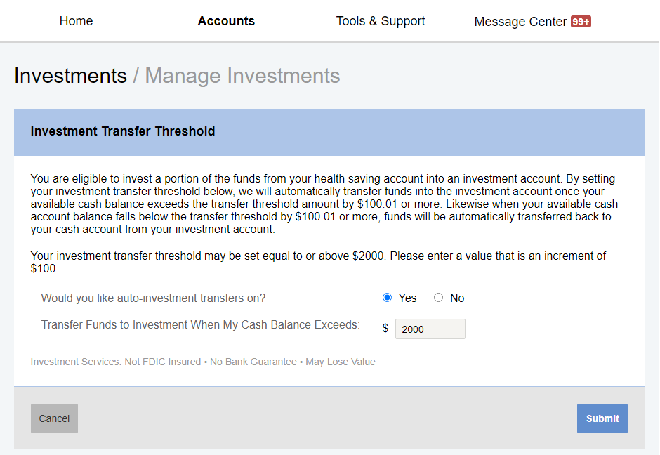
Investment Overview
The first $2,000 contributed to the account must remain in a cash account.
After accumulating $2,000, you may invest additional contributions in one of several investment options.
You can begin the process of setting up your funds over $2,000 to move to investments by establishing your Investment Transfer Threshold.
Click on “View Investment Summary” from your Home page and then the Edit link next to “Investment Auto-Transfer” to set your threshold.
Check off the check box, define your investment sweep dollar amount (must be $2,000 or more), and then click “Save”

Slide 24
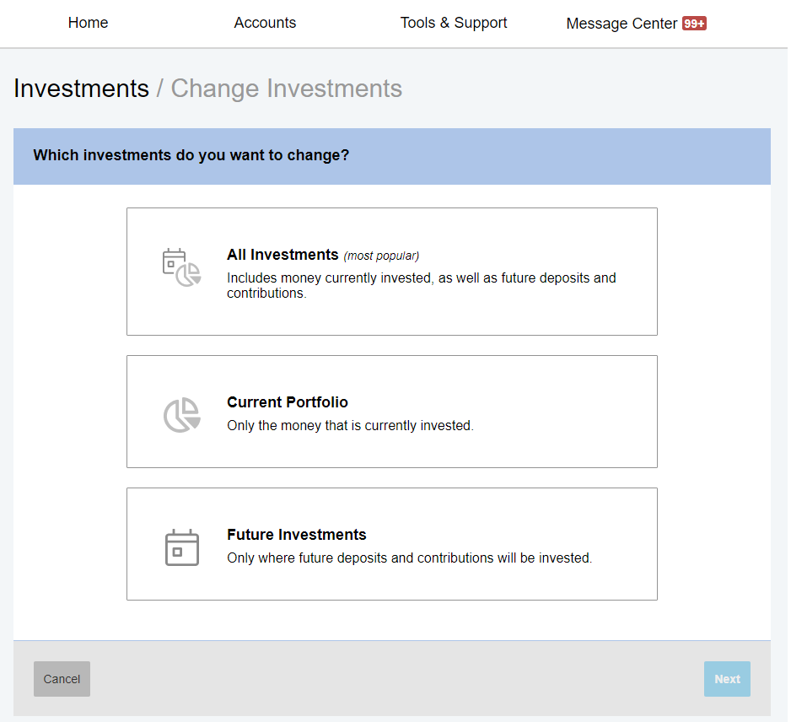
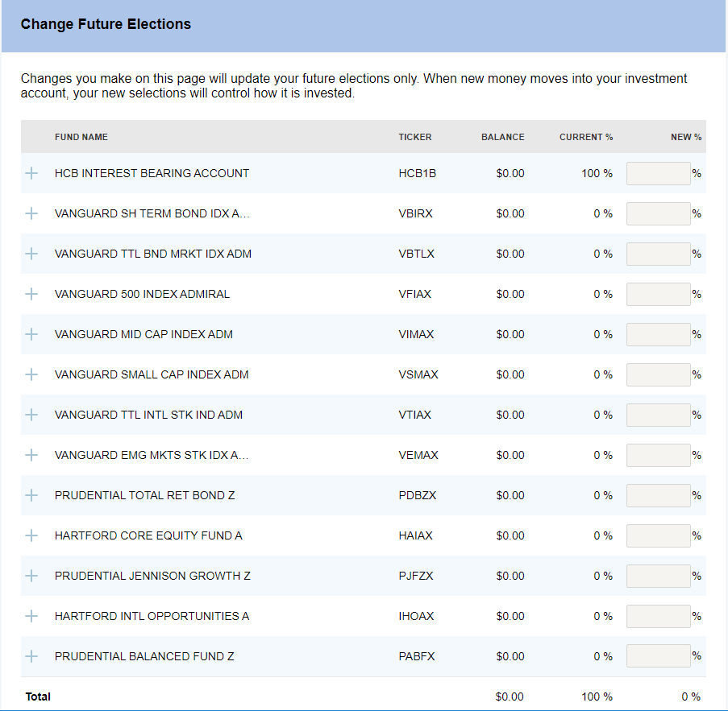
Manage Your Investments
Your HSA account has a wide variety of investment options with varying risk tolerance levels.
Click the “Change Investments” button from your Investment Summary page for a step-by-step process of changing existing and/or future investments.

Slide 25

Contact us!
We’re here to help…sentinelgroup.com
Notes:
Sample Closing Slide

